Slide 1



PREVENTION OF DISEASE OUTBREAK IN NIGERIA
View in Power BI
Last data refresh:
03/11/2024 09:35:11 UTC
Downloaded at:
03/11/2024 09:39:58 UTC

Slide 2
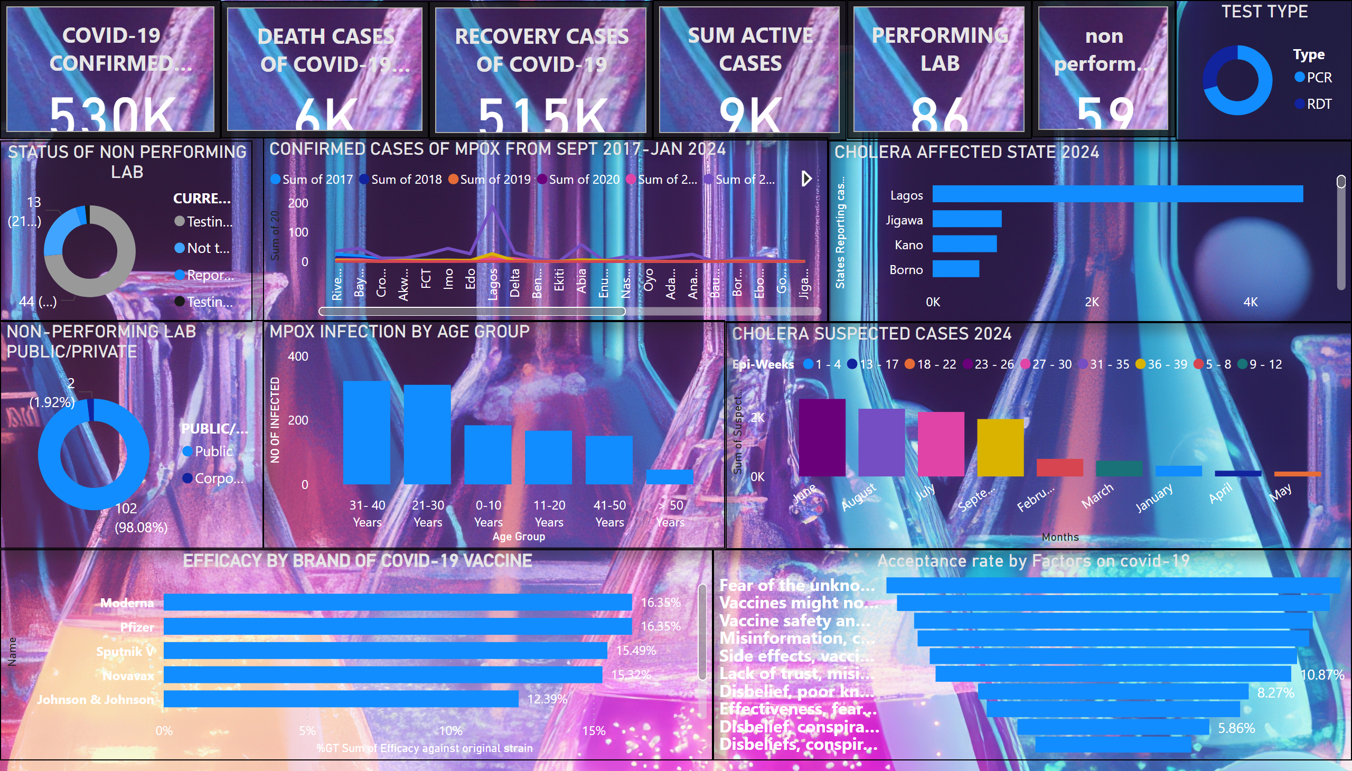
DASHBOARD
Notes:
cardVisual
No alt text provided
cardVisual
No alt text provided
cardVisual
No alt text provided
cardVisual
No alt text provided
cardVisual
No alt text provided
cardVisual
No alt text provided
STATUS OF NON PERFORMING LAB
No alt text provided
NON-PERFORMING LAB PUBLIC/PRIVATE
No alt text provided
TEST TYPE
No alt text provided
CONFIRMED CASES OF MPOX FROM SEPT 2017-JAN 2024
No alt text provided
CHOLERA AFFECTED STATE 2024
No alt text provided
CHOLERA SUSPECTED CASES 2024
No alt text provided
MPOX INFECTION BY AGE GROUP
No alt text provided
EFFICACY BY BRAND OF COVID-19 VACCINE
No alt text provided
Acceptance rate by Factors on covid-19
No alt text provided

Slide 3
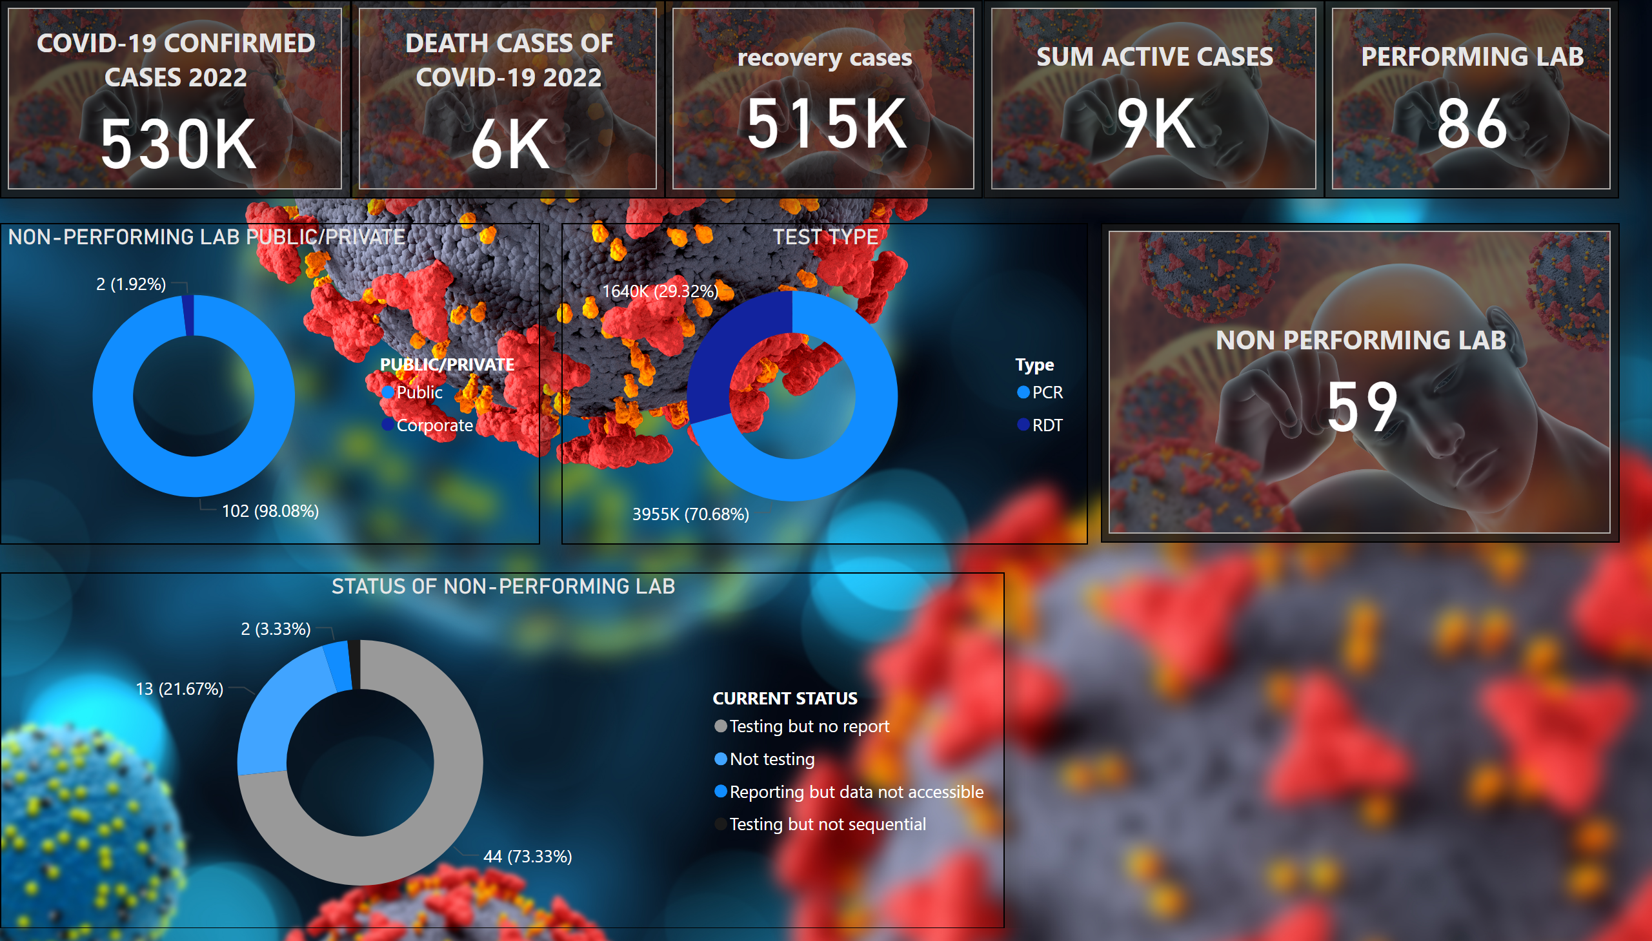
CORONA VIRUS
Notes:
cardVisual
No alt text provided
cardVisual
No alt text provided
cardVisual
No alt text provided
cardVisual
No alt text provided
cardVisual
No alt text provided
NON-PERFORMING LAB PUBLIC/PRIVATE
No alt text provided
TEST TYPE
No alt text provided
STATUS OF NON-PERFORMING LAB
No alt text provided
cardVisual
No alt text provided

Slide 4
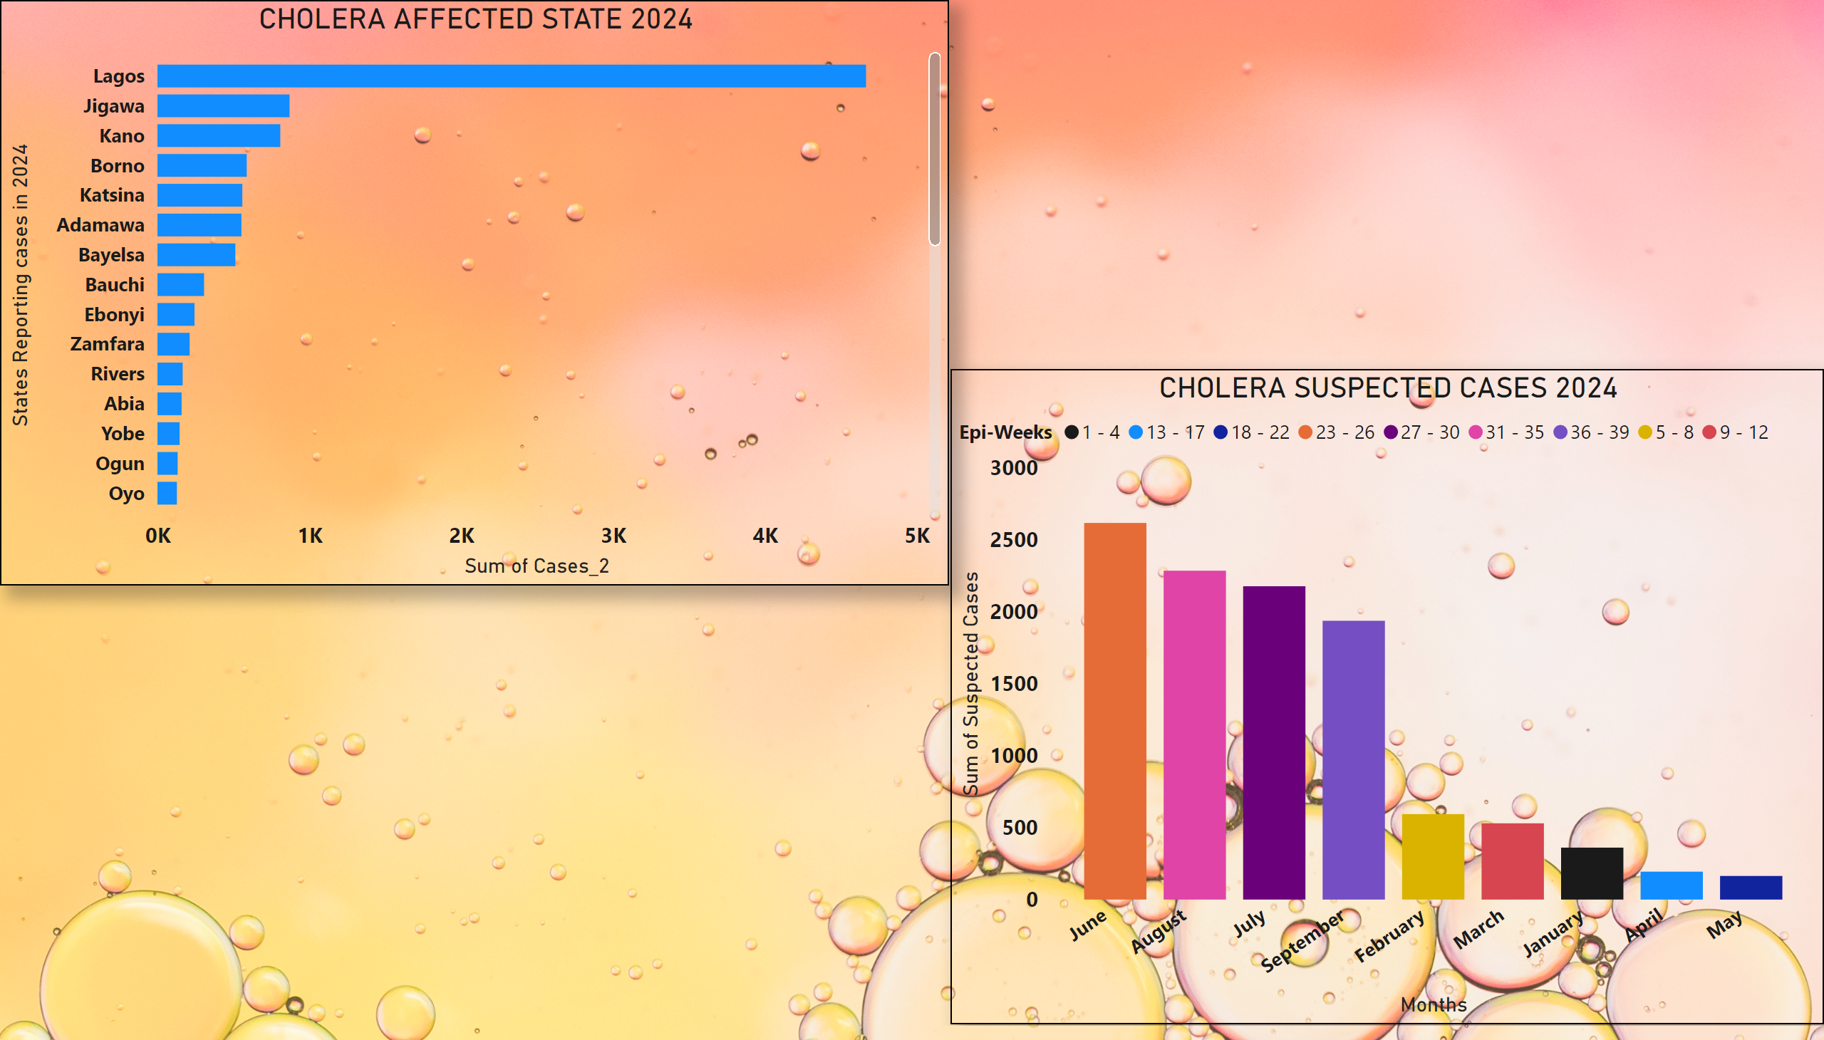
CHOLERA
Notes:
CHOLERA SUSPECTED CASES 2024
No alt text provided
CHOLERA AFFECTED STATE 2024
No alt text provided

Slide 5
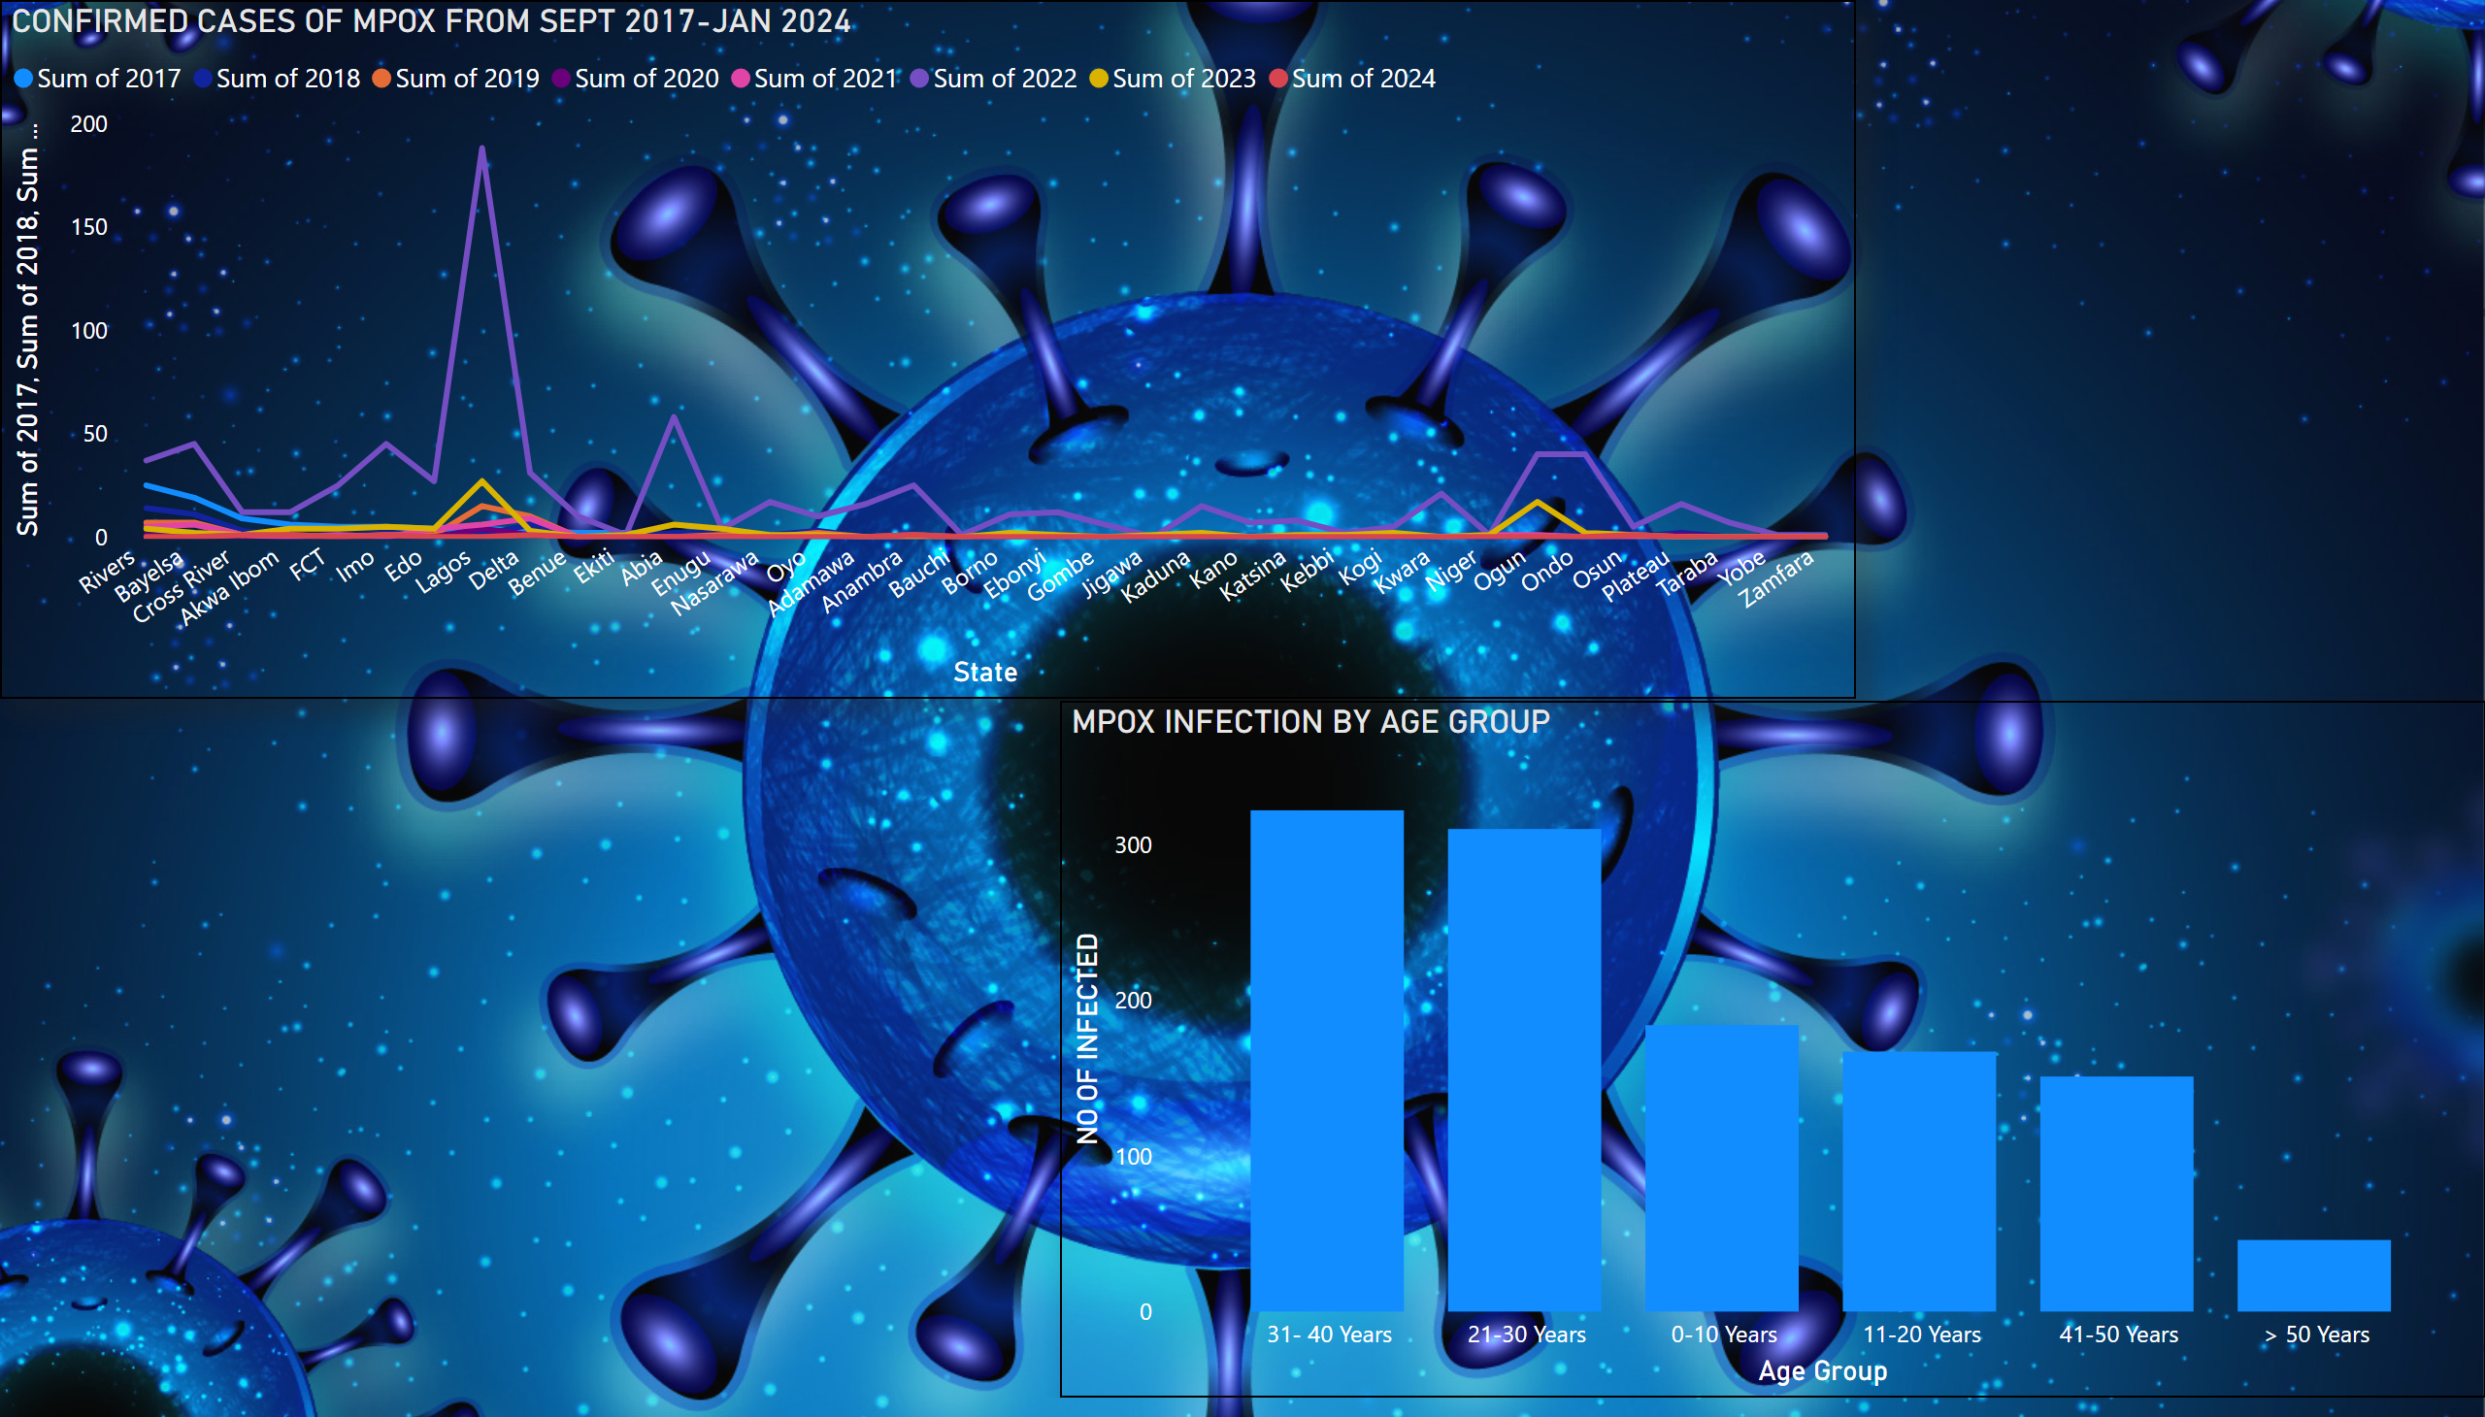
MPOX
Notes:
CONFIRMED CASES OF MPOX FROM SEPT 2017-JAN 2024
No alt text provided
MPOX INFECTION BY AGE GROUP
No alt text provided

Slide 6
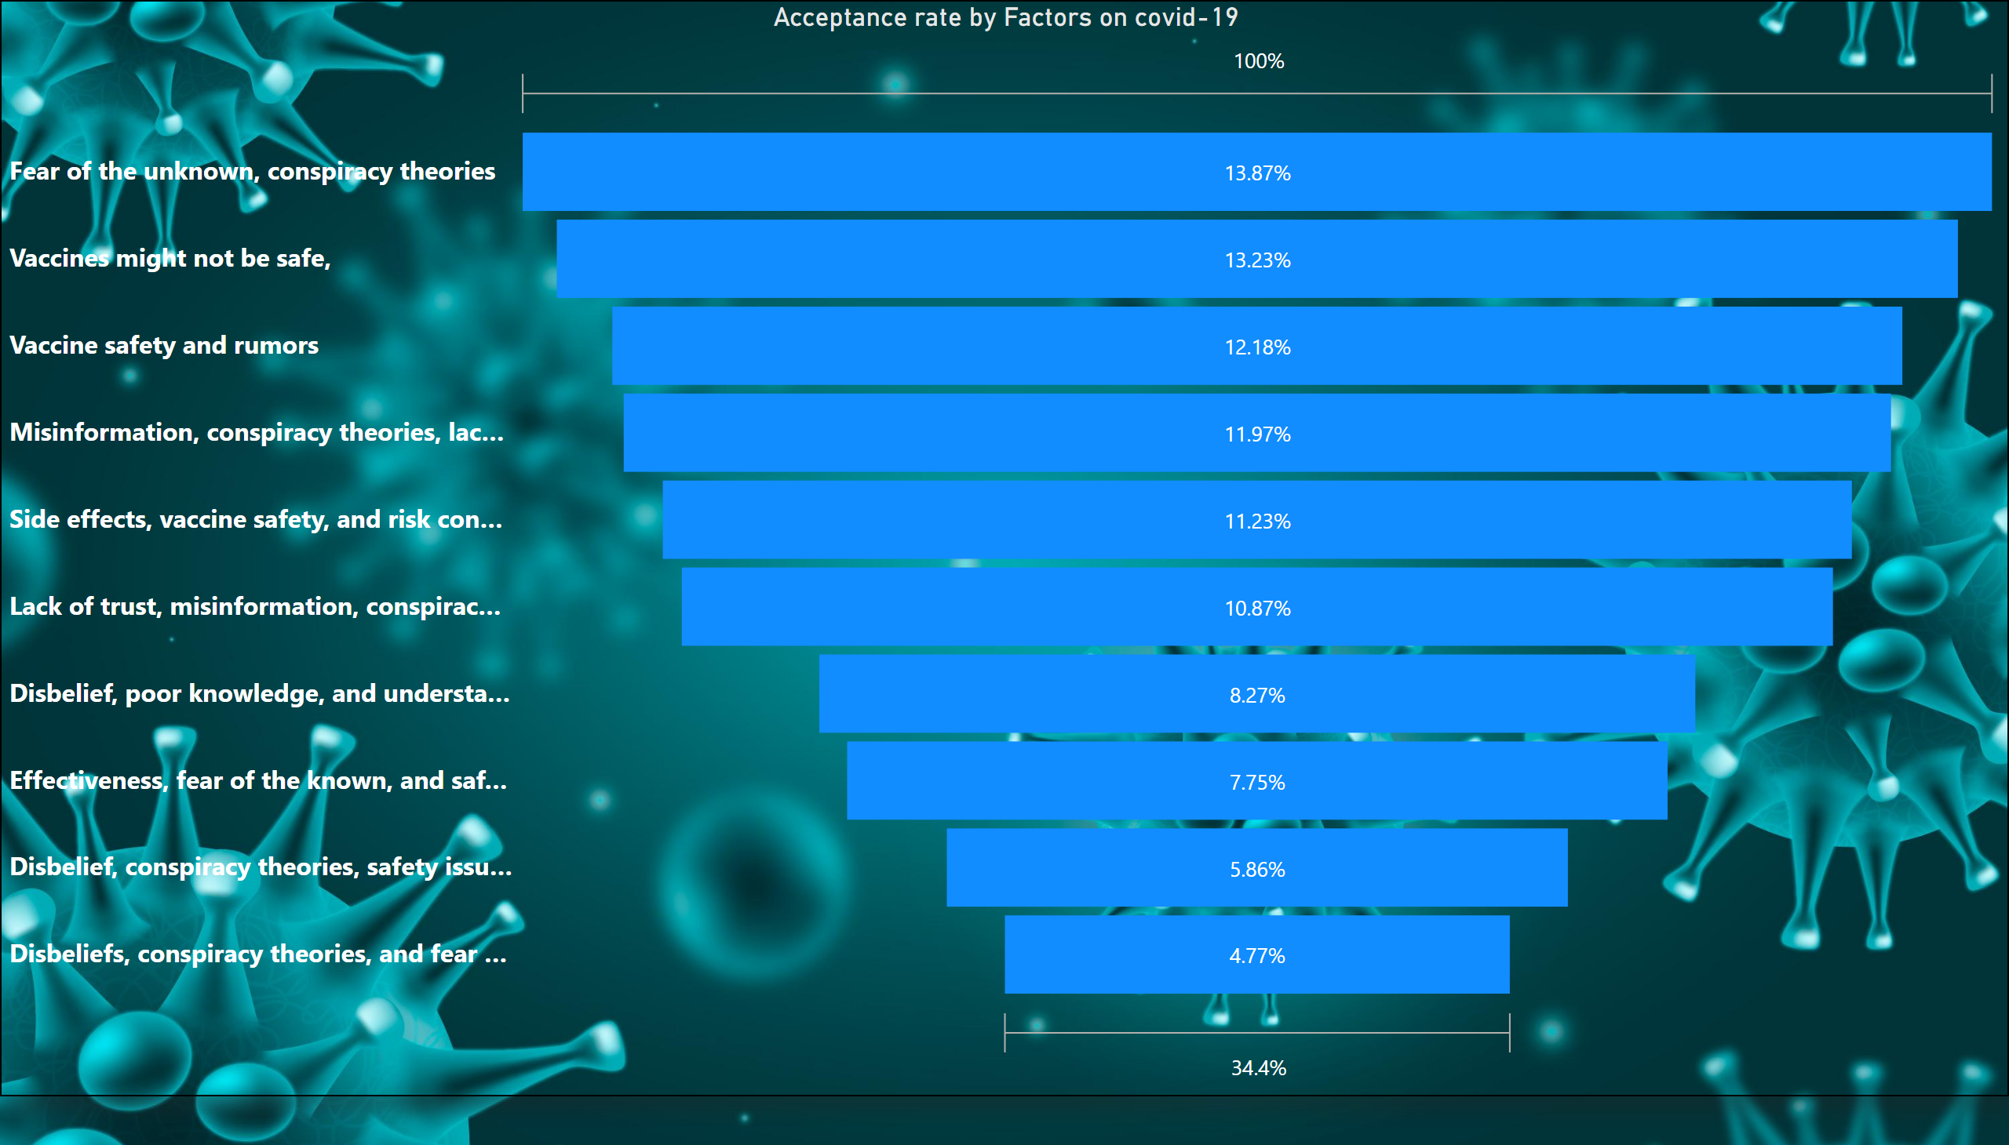
PREVENTION
Notes:
Acceptance rate by Factors on covid-19
No alt text provided

Slide 7
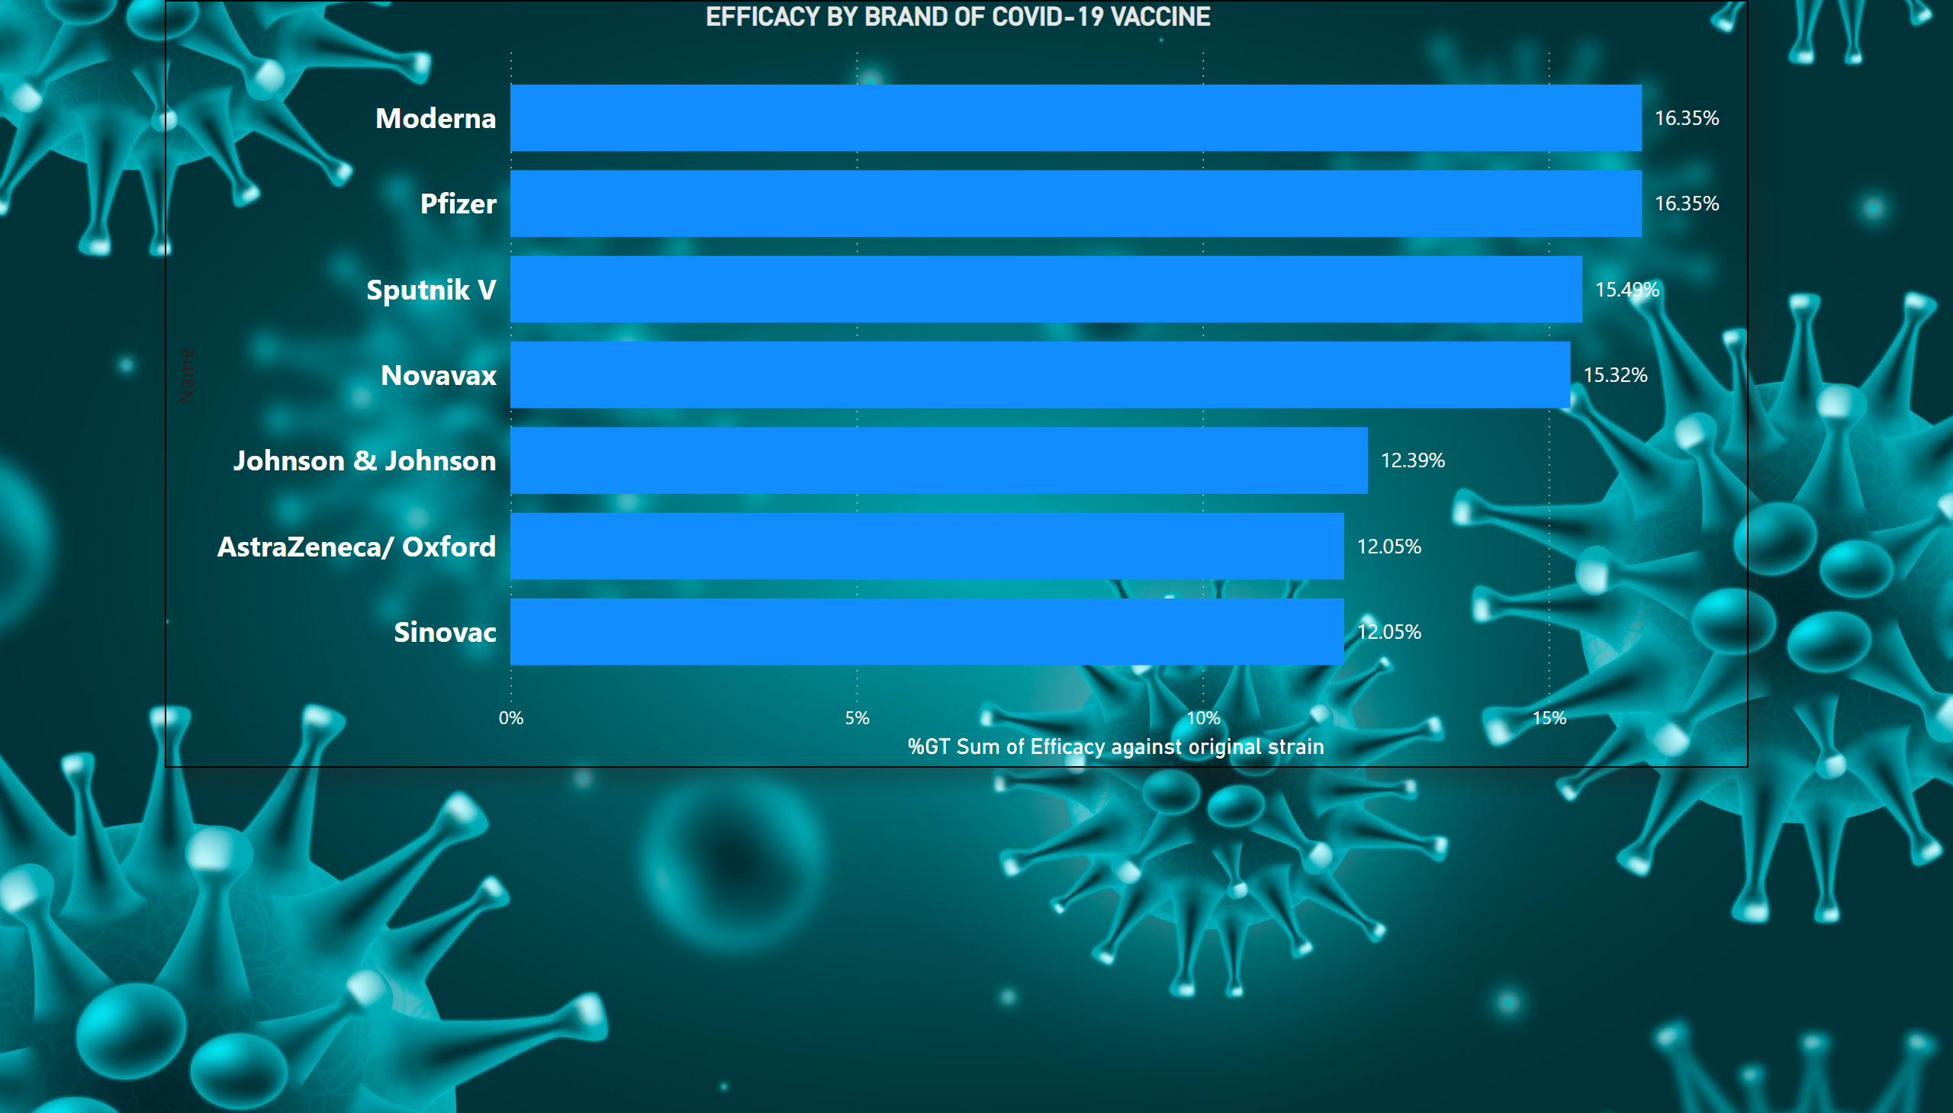
Page 2
Notes:
EFFICACY BY BRAND OF COVID-19 VACCINE
No alt text provided

Slide 8
REFERENCE
Olu-Abiodun, Oluwatosin, et al. “COVID-19 Vaccination in Nigeria: A Rapid Review of Vaccine Acceptance Rate and the Associated Factors.” PLOS ONE, vol. 17, no. 5, 11 May 2022, p. e0267691, https://doi.org/10.1371/journal.pone.0267691.
Dimie Ogoina, Mahmmod Muazu Dalhat, Ballah Akawu Denue, Okowa, M., Nneka Marian Chika-Igwenyi, Sebastine Oseghae Oiwoh, Ekaete Alice Tobin, Hakeem Abiola Yusuff, Anastacia Okwudili Ojimba, Umenzekwe Chukwudi Christian, John-Tunde Aremu, Simji Samuel Gomerep, Kambai Lalus Habila, Sati Klein Awang, Olukemi Adekanmbi, Iroezindu, M., Asukwo Onukak, Olanrewaju Falodun, Sunday, M., & Simon Mafuka Johnson. (2024). Mpox Epidemiology and Risk Factors, Nigeria, 2022. Emerging Infectious Diseases, 30(9). https://doi.org/10.3201/eid3009.240135
‌
Nigeria Centre for Disease Control. (n.d.). Ncdc.gov.ng. https://ncdc.gov.ng/diseases/sitreps/?cat=8&name=An%20Update%20of%20Monkeypox%20Outbreak%20in%20Nigeria
‌

